Slide 1


Slide 2
The Role of Public Lands in the
Grand County Economy
An Overview of the Segments of Our Economy and the Role Tourism and Recreation
Challenges and Conflicts of Multiple Use Management on Public Lands: Recreation vs. Resource Extraction
Choices for the Future of Grand County’s Economy

Slide 3
Grand County
Percent Total Employment by Sector 2009
Accommodations/Food Service 21.8%
Arts/Entertainment/Rec 5.7%
Retail Trade 13.6%
Total Tourism/Travel 41.1%
(aka Leisure and Hospitality)
Source: U.S. Department of Commerce Bureau of Economic Analysis

Slide 4
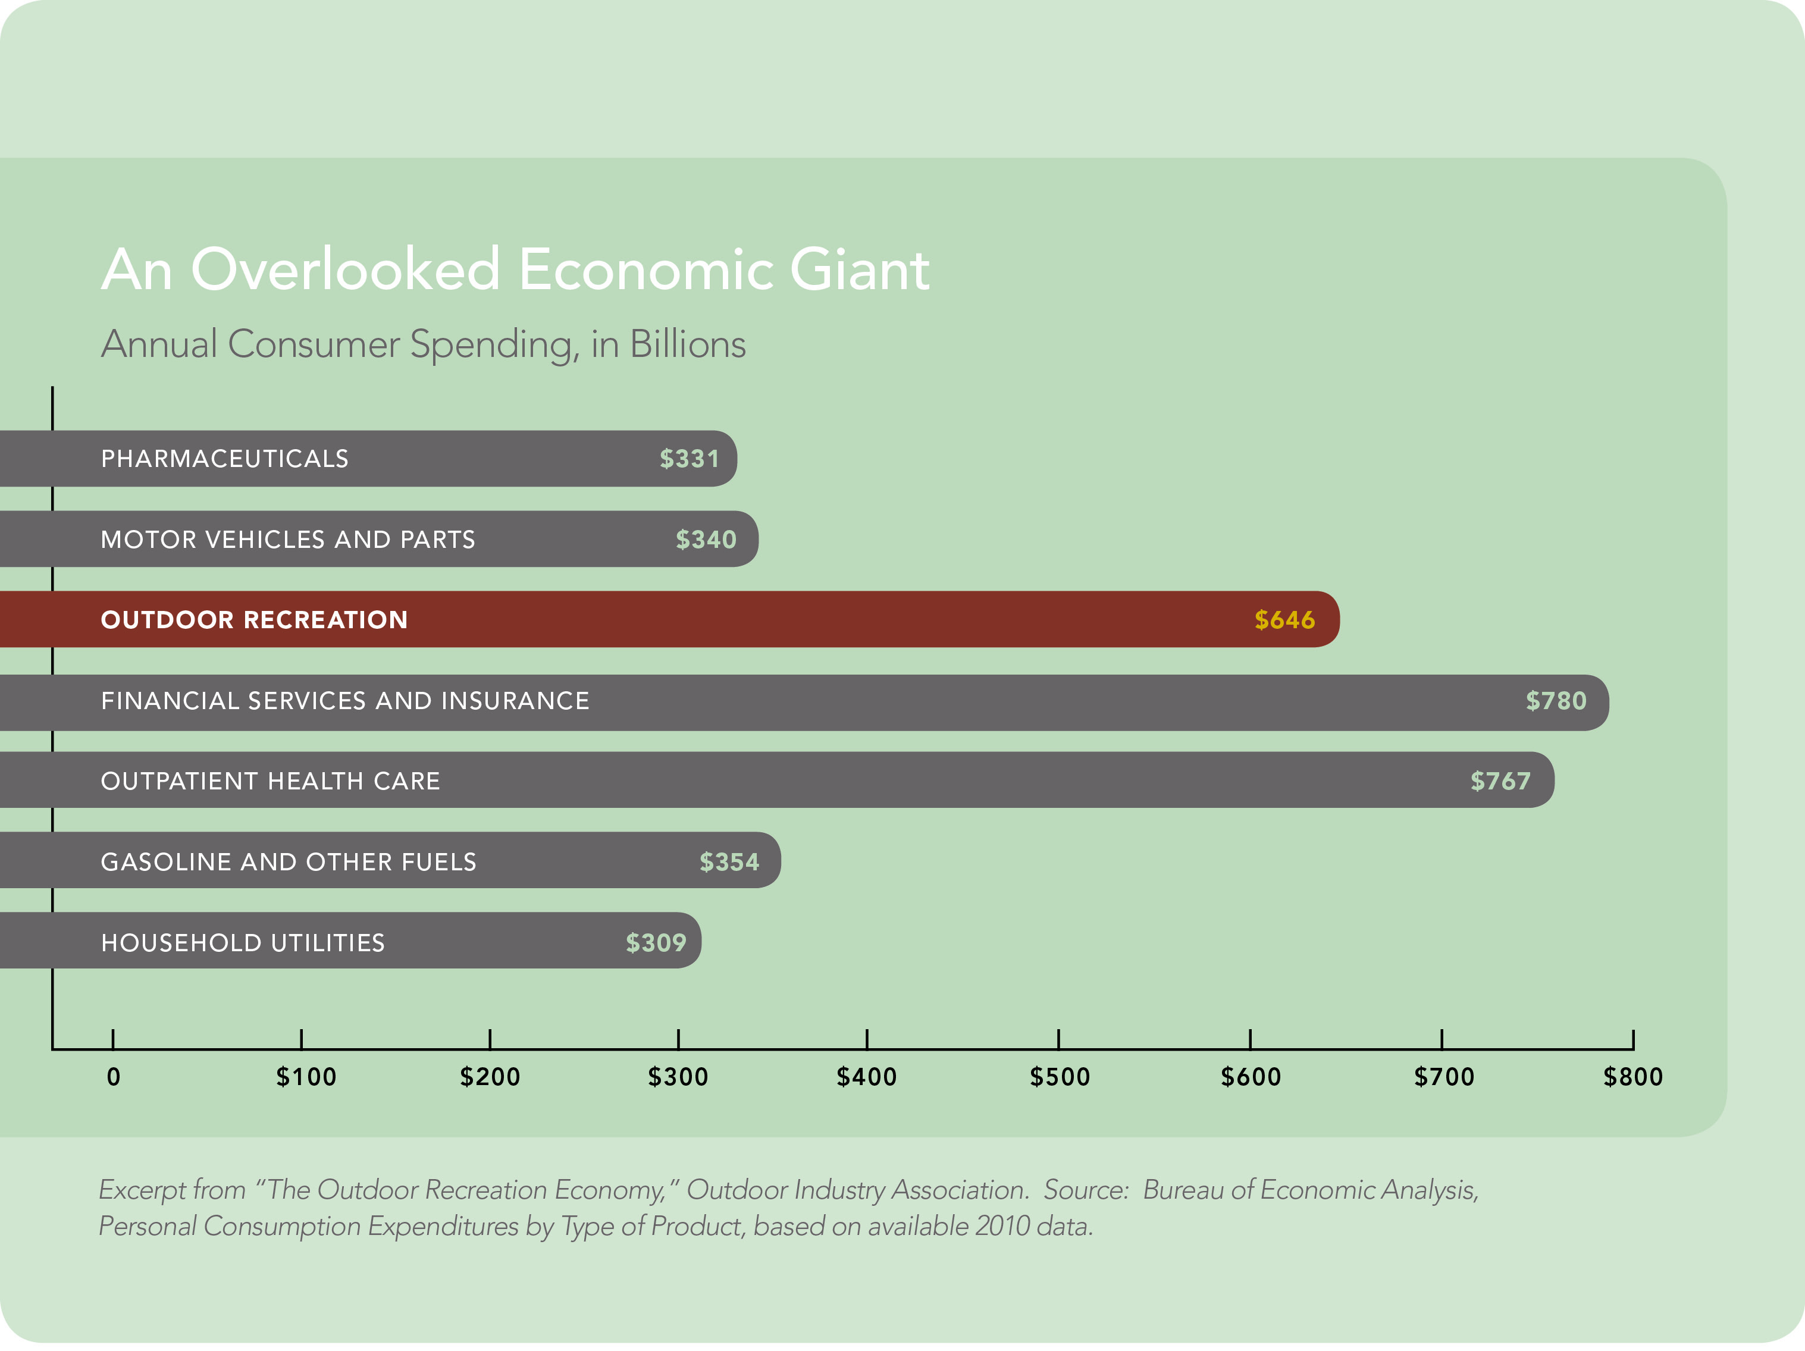
Industry Comparisons Nationally:
Source: Outdoor Industry Association

Slide 5
Grand County
Economy 2013
Grand County
Budget 2013
(in millions)
Taxes, Fees, PILT $10.9 39%
Restaurant/Room Tax $ 3.6 13%
Grants $ 8.1 29%
EMS/Sandflats $ 1.2 4%
State Road Allocation $ 2.6 9%
Mineral Lease $ 1.9 7%
Total $28.5
(in millions)
Leisure and Hospitality
Taxable Sales $110.7
- up from $104.7 in 2012
- 41.1% of Grand County’s Economy
All Other Revenue Sources
Estimated $159.3
Estimated Total $270.0
Sources: Grand County Clerk, Utah Department of Transportation Federal Mineral Lease and Acquired Lands Rents and Royalties Allocation
To County Special Service Districts Fiscal Years 2013 / 2014, U.S. Department of Commerce. 2011. Bureau of Economic Analysis, Regional
Economic Information, Bureau of Economic and Business Research University of Utah

Slide 6
Utah and Grand County Data
Wages in Grand County were up in 2013 by 6.3 %, nationwide up by 4.1%
Between 2003 and 2012:
- Canyonlands NP visitation grew by 702% and Arches grew by 269%
    - Total tourism-oriented direct employment increased by 13%
    - Tourism-oriented wages went up by 14%
    - Visitation to Utah’s ski resorts increased by 18%
    - Visitation to Utah’s National Parks increased by 30%
    - Utah’s arts and recreation industry increased private jobs by 9.8%,
    and earning 7.2%—despite the recession
65%of Utahns participate in outdoor recreation at least once a week.
Utah showed positive year-over increases in almost all tourism-related areas, including tax revenues (8.5 %), taxable sales (6.0 %), leisure and hospitality jobs and wages (4.1 %and 5.5 %).
Source: Bureau of Economic and Business Research University of Utah

Slide 7
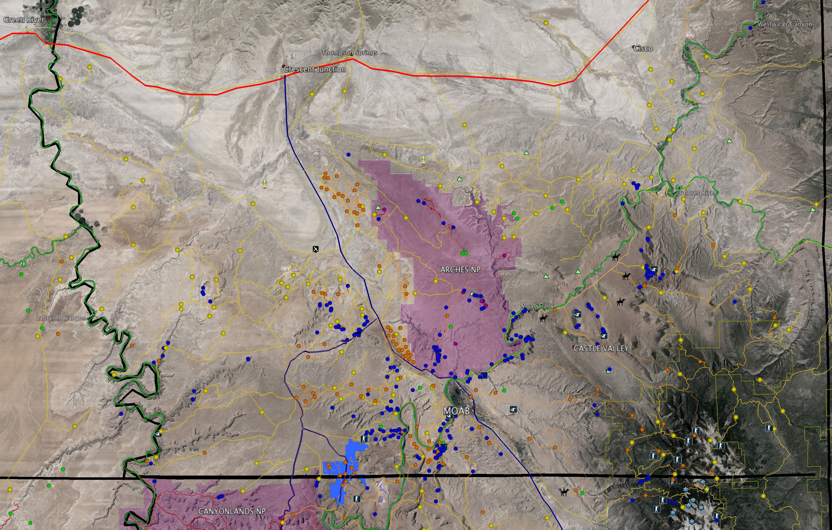
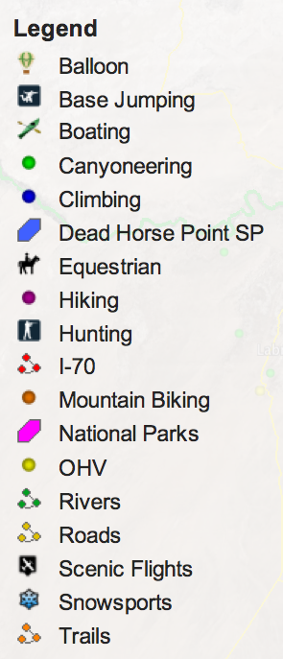
Role of Public Lands: Grand County Recreation Audit

Slide 8
Land Ownership, Wealth Generation and the Footloose Economy of the 21st Century
Boeing Sets Up Hood River Support Center
HOOD RIVER - Boeing’s new Hood River digs on the building’s east end will help the company service one of its many products. Jim Mutchler and Dan Sauer, Field Service Representatives for Boeing …”
Software Firm Co-founder Details Plans For High-Tech Development in State
HELENA - Greg Gianforte, who co-founded the Bozeman software firm that he sold to Oracle Corp. for $1.8 billion, has unveiled a website to promote his plans for high-tech development for Montana – and says he’s in it for the long haul.
Contemporary Moves to Bend
BEND - … “We love the outdoor lifestyle,” Dr. Porter adds. “You can’t beat the scenery, community, small town feel …”

Slide 9
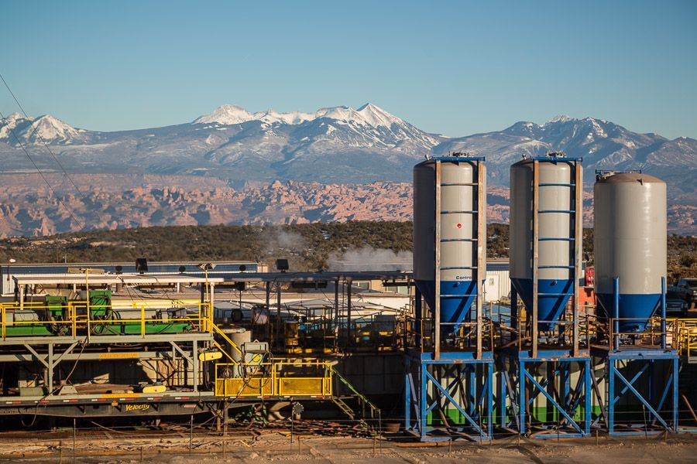
Degradation of Recreation Assets
Recreation vs. Resource Extraction
Current Leasing Procedures
  Parcel by parcel nomination process
  Stipulations at time of lease
  Conditions when Application for Permission to Drill is processed

Slide 10
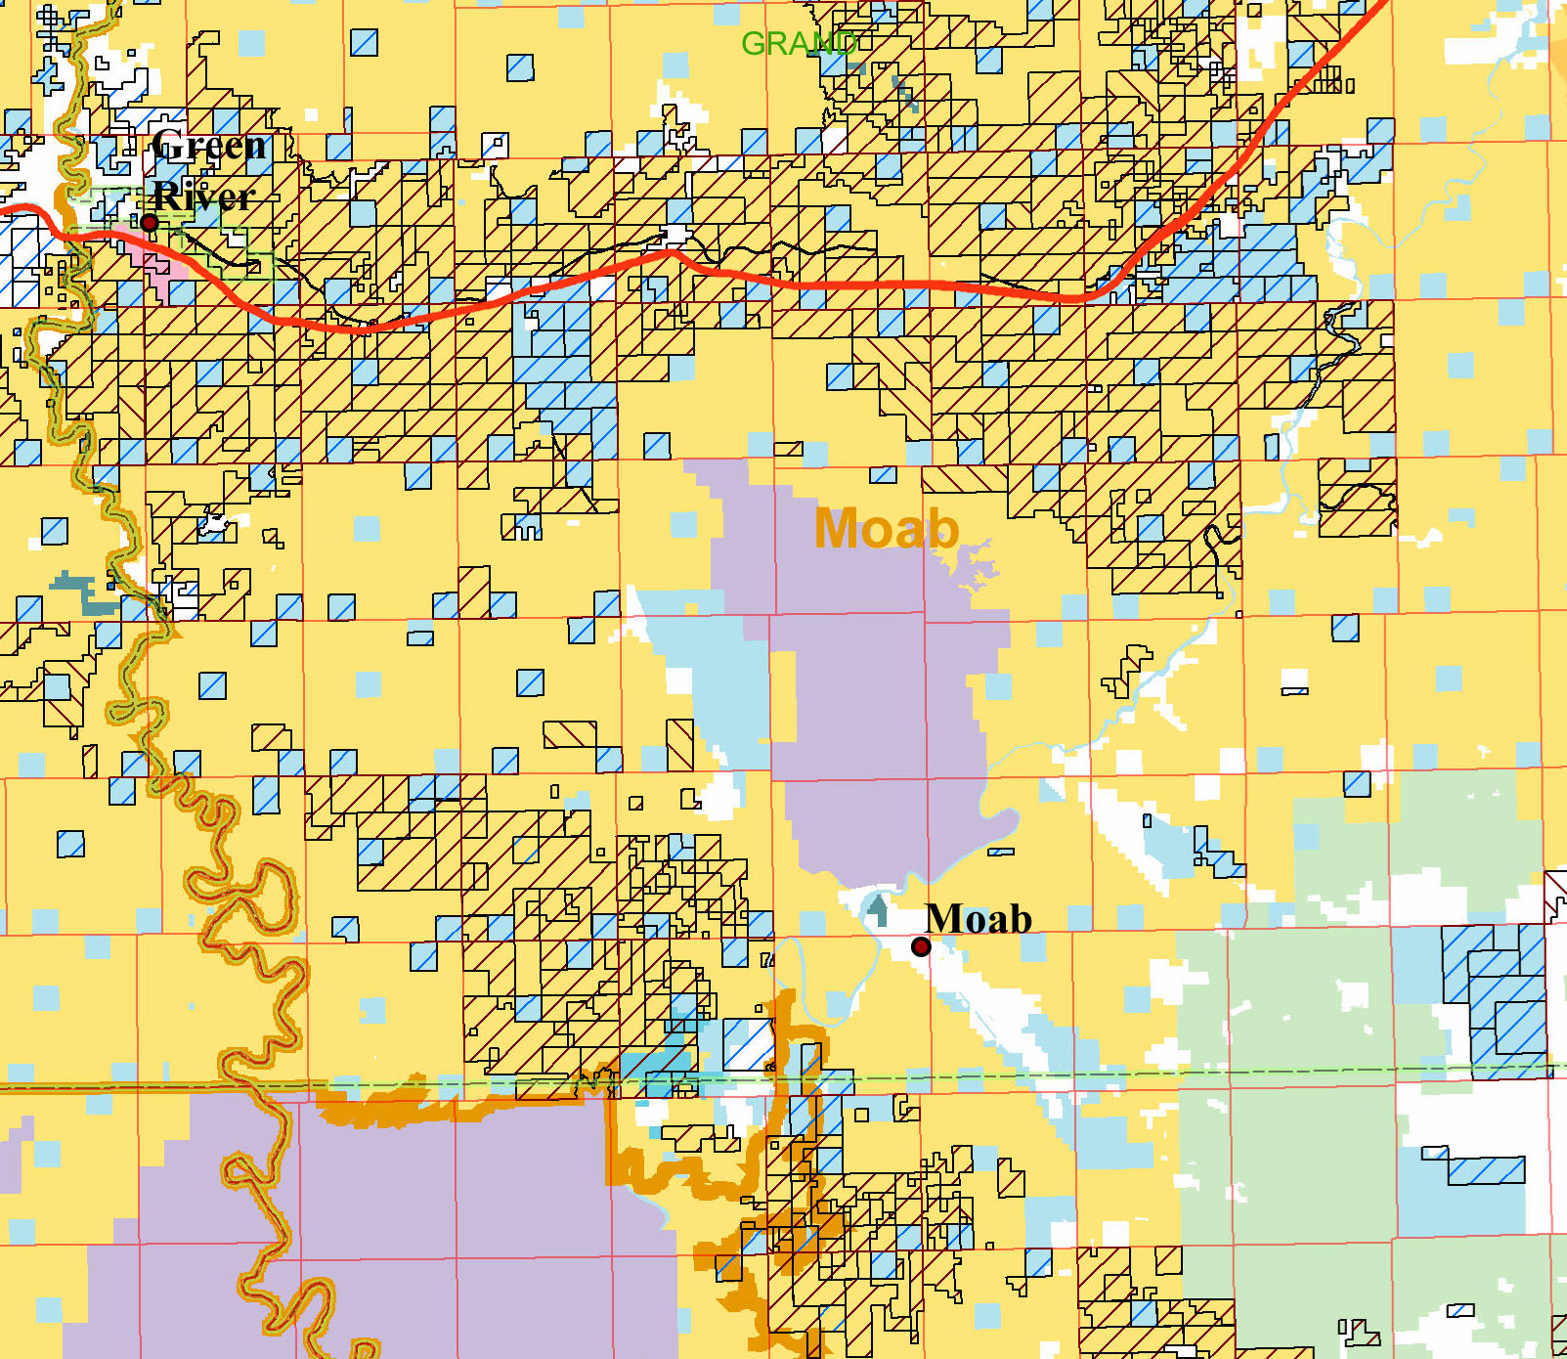
Lands Currently Leased for Oil, Gas, and Potash

Slide 11
Choices for Moab:
If the community chooses to balance extractive resources and recreation by:
  Investing in recreation assets
  Committing to clean air and water
  Recruiting quality of life businesses and residents
What tools are available to achieve these goals:
  Legislation / The Bishop Initiative
  Land Use Planning / Moab Master Leasing Plan
  Executive Action / National Monument

Slide 12
Legislation: The Bishop Initiative
Pros:
Wilderness Study Areas are resolved
Other designations such as National Recreation Areas or National Conservation Areas can be designed to meet the needs of local community
SITLA parcels can be consolidated
Industrial areas are clearly identified and conflicts reduced
Investors in both recreation and industry have more certainty
Cons
An act of Congress is required

Slide 13
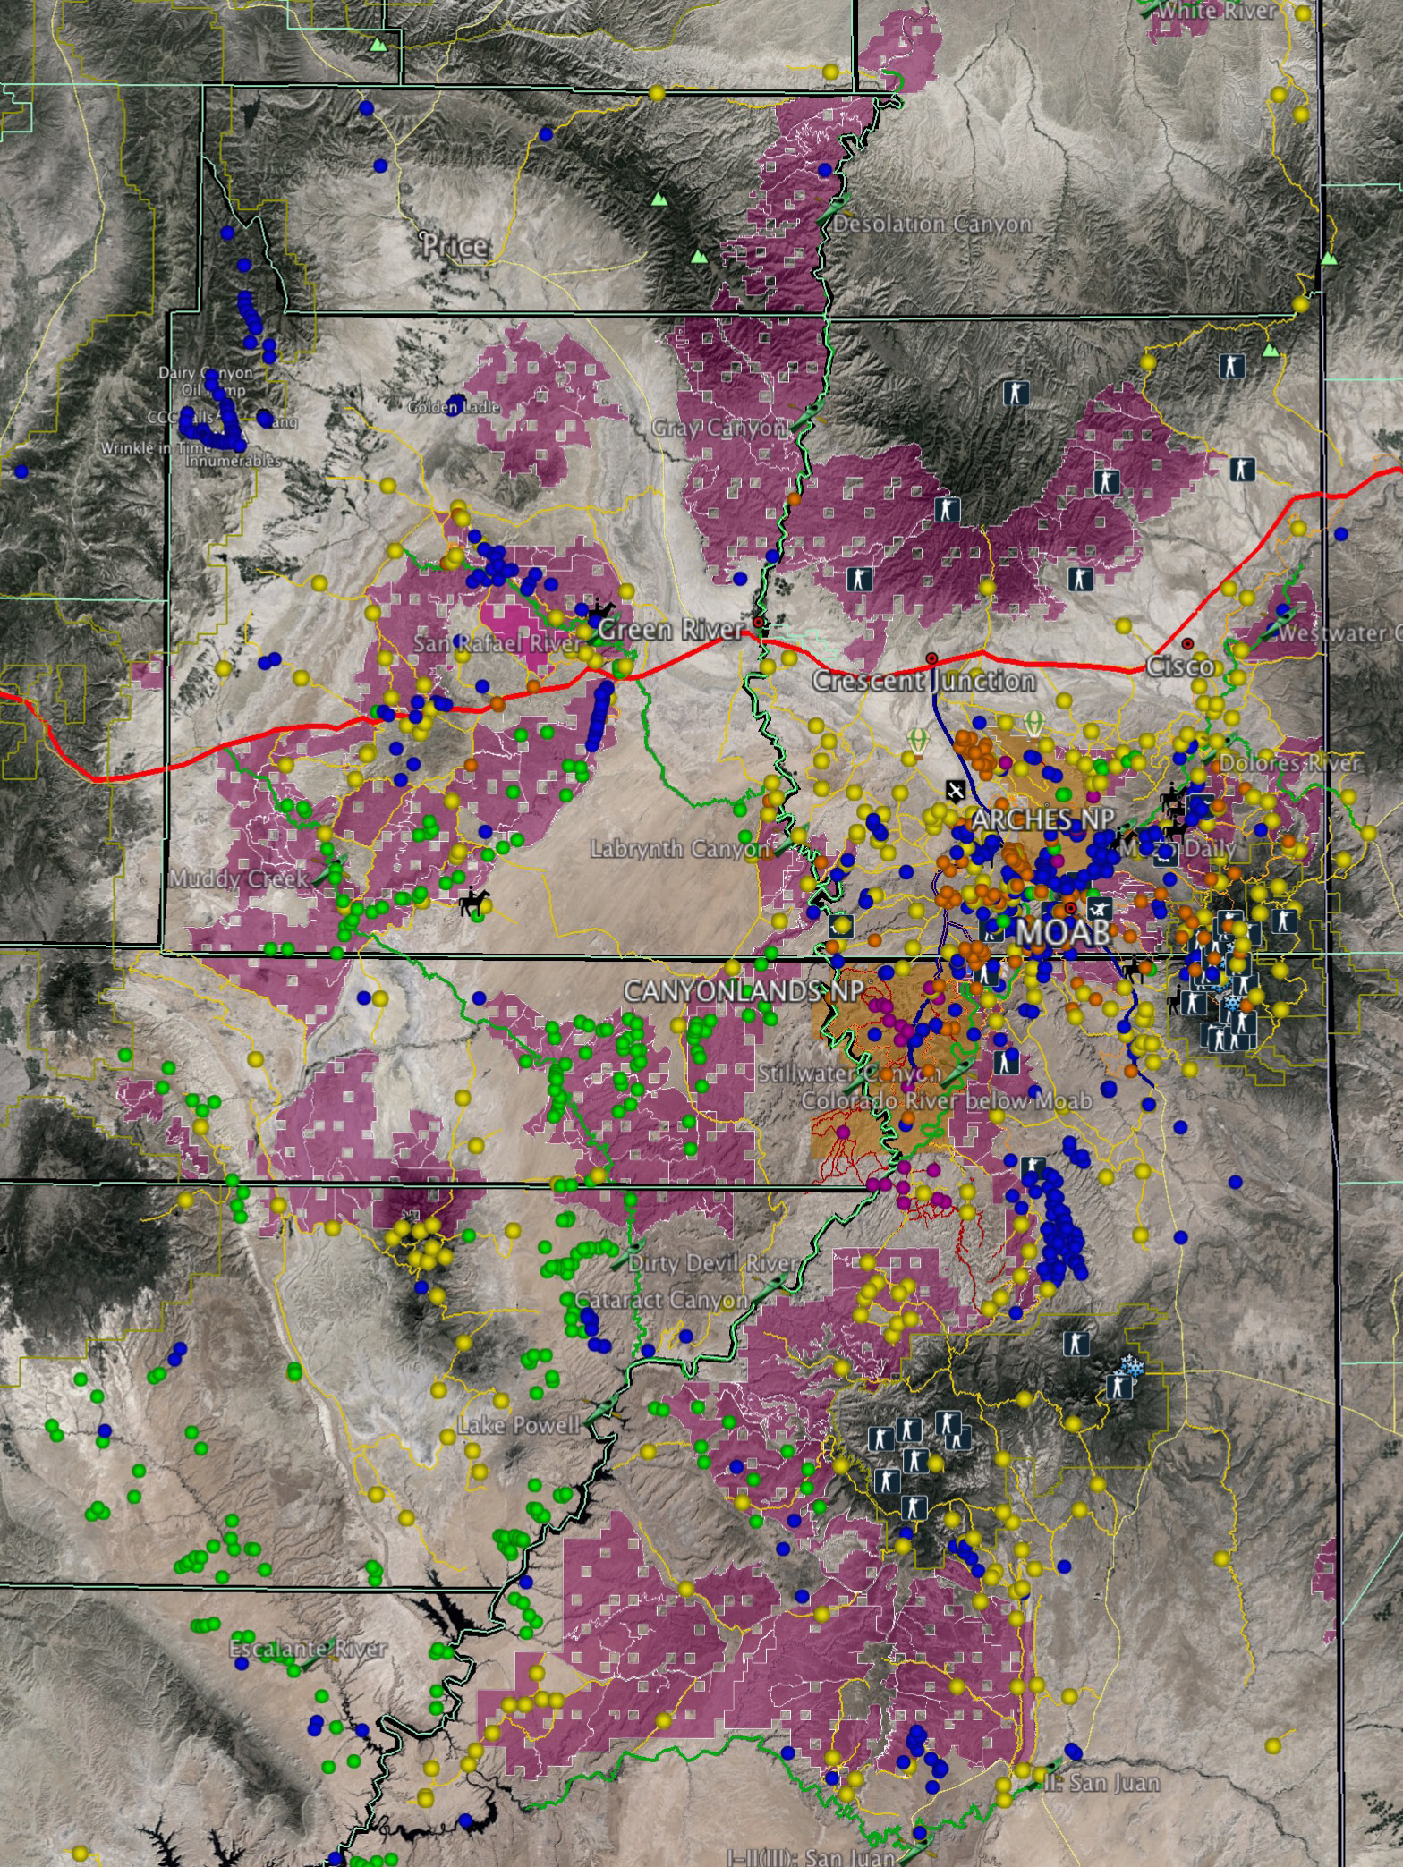
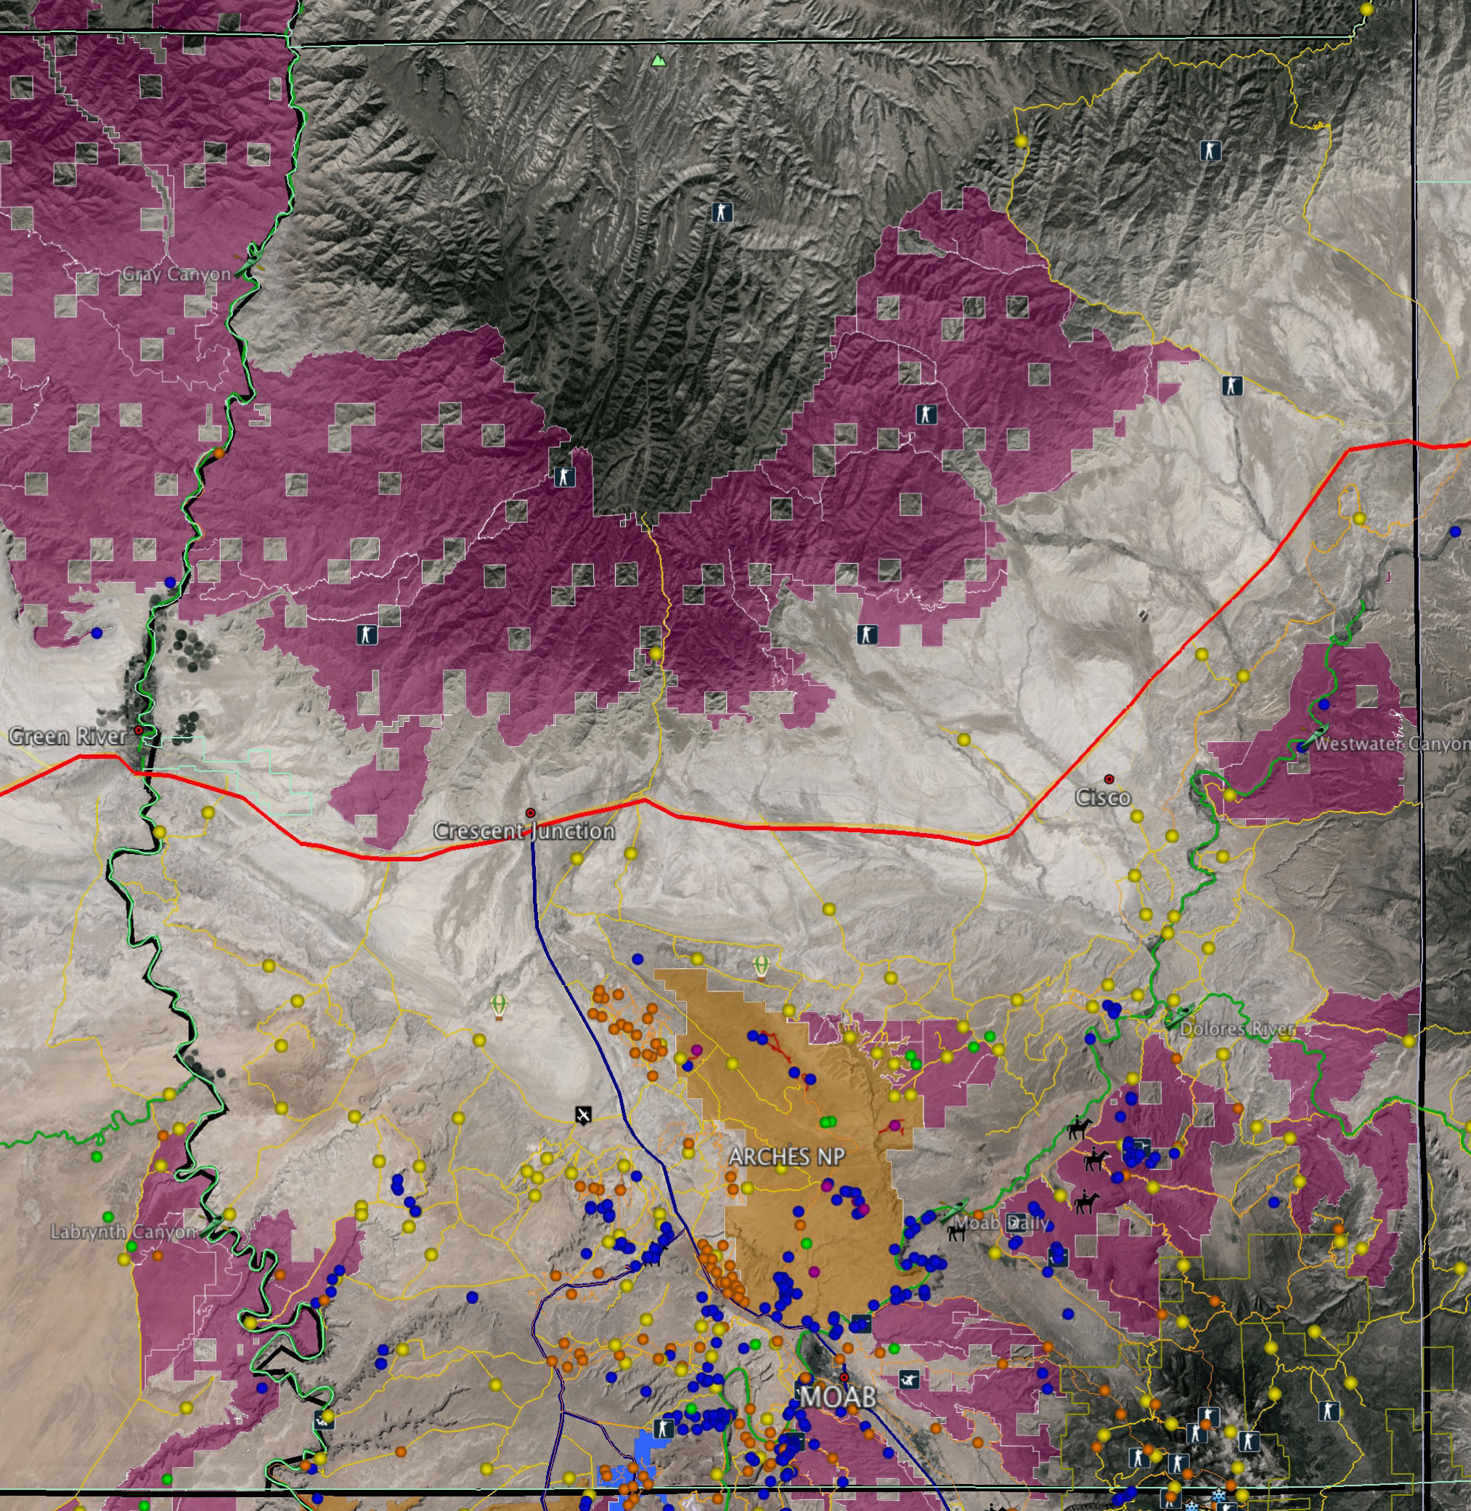
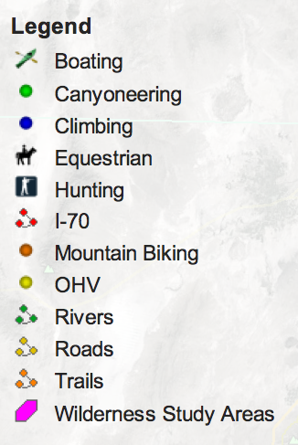
Wilderness Study Areas in Grand County and
Eastern Utah

Slide 14
Land Use Planning:
Moab Master Leasing Plan
Pros:
In progress, likely to be completed in 2015
Stakeholder process
Alternatives allow public input
Cons:
Not permanent (legislation can over-ride), therefore less investor certainty

Slide 15
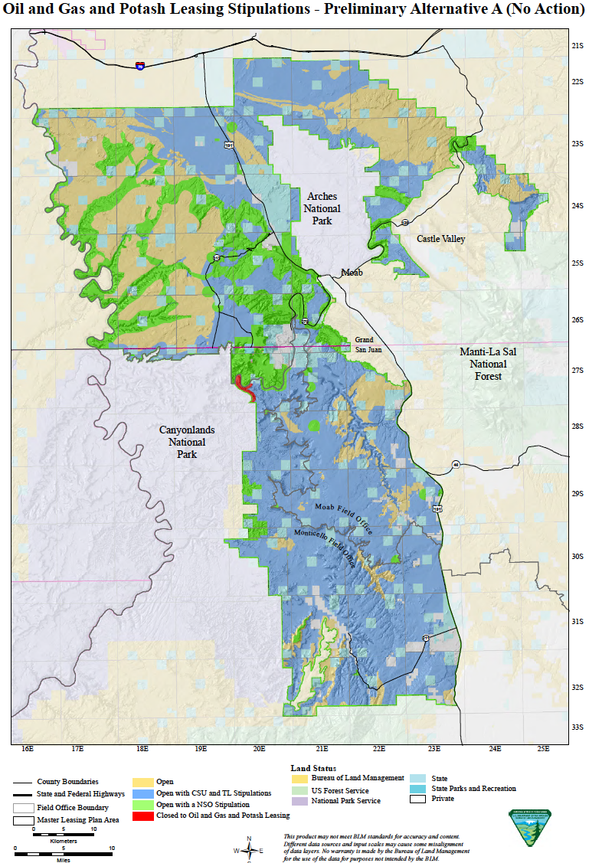
Moab Master Leasing Plan
Existing stipulations in BLM’s current RMP (no action alternative) for oil and gas
Three additional action alternatives, B1, B2 and C

Slide 16
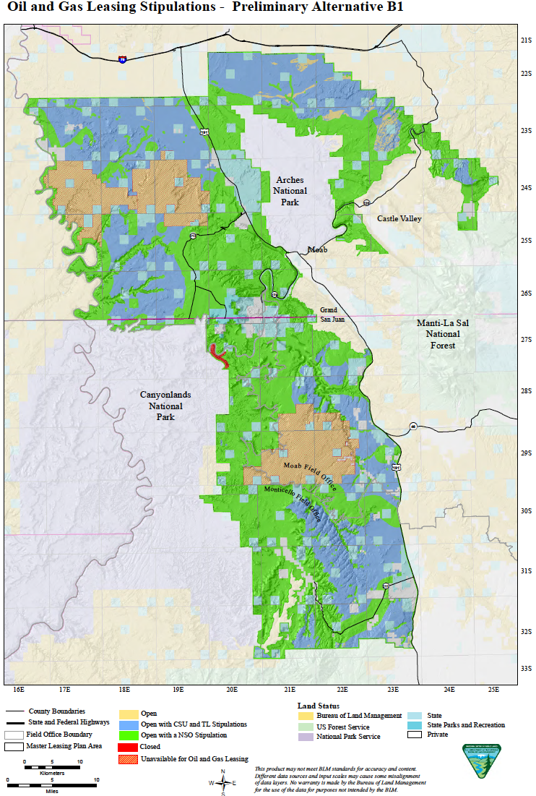
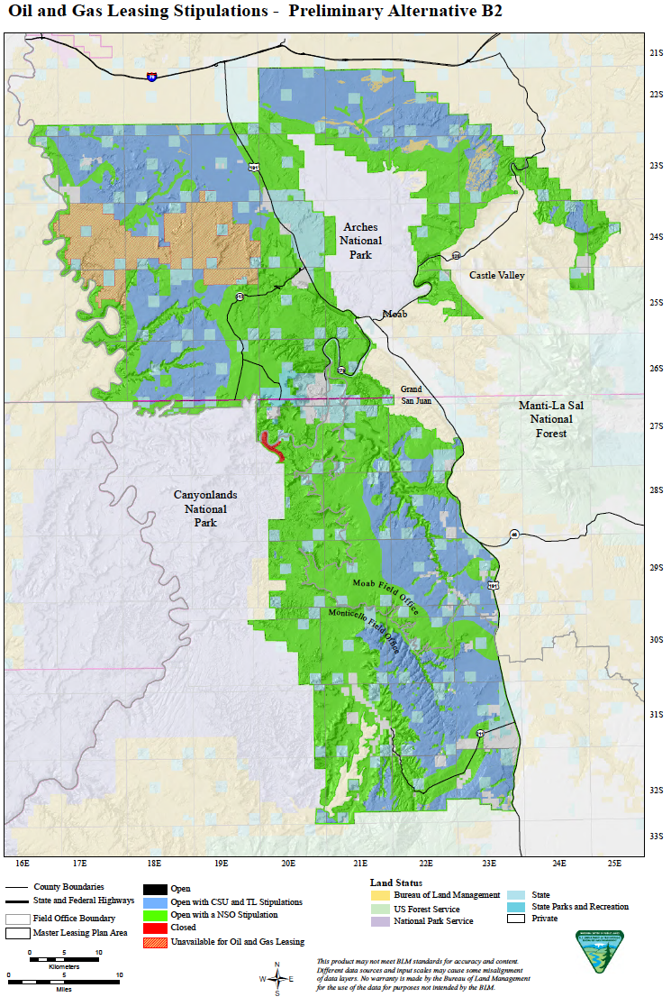
Preliminary Alternatives B1 and B2

Slide 17
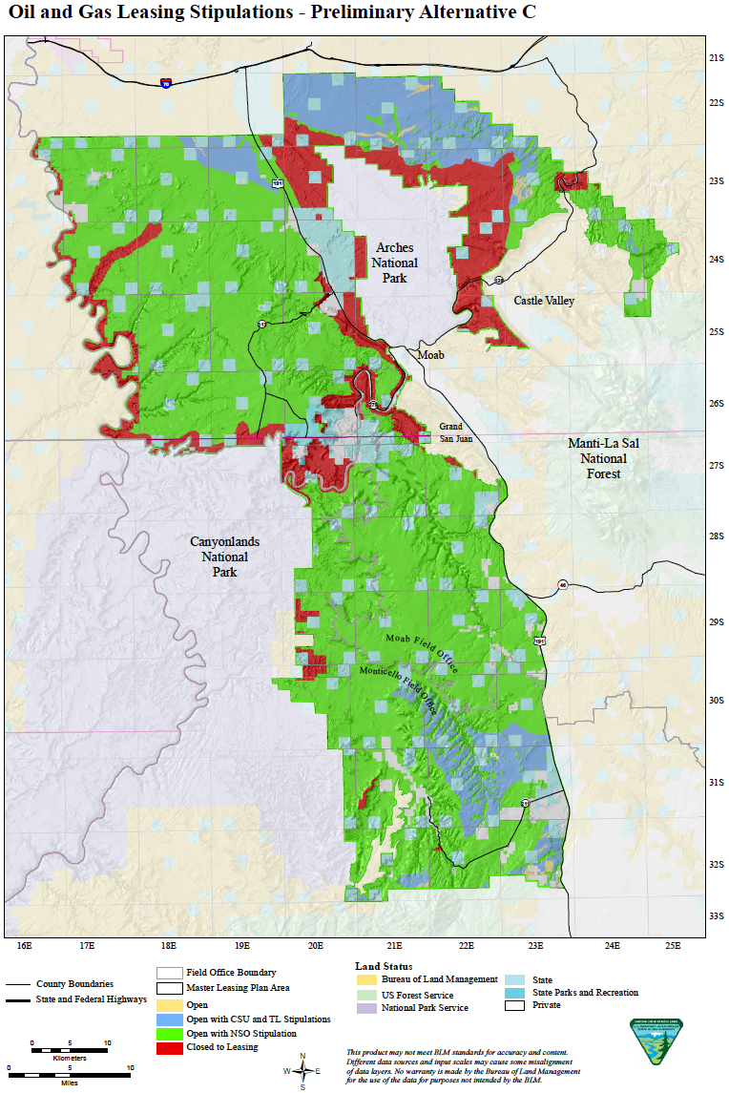
Alternative C and Business Proposal

Slide 18
Lands Currently Leased for Oil, Gas, and Potash

Slide 19
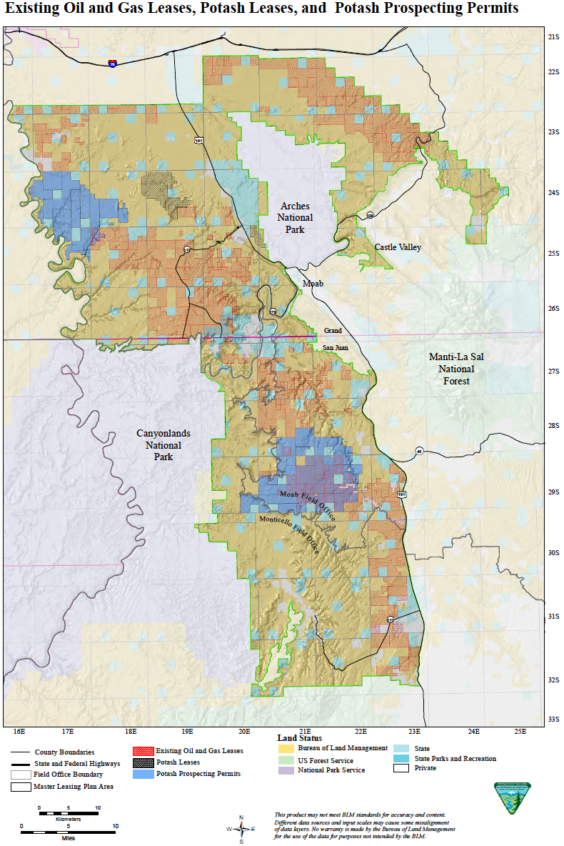
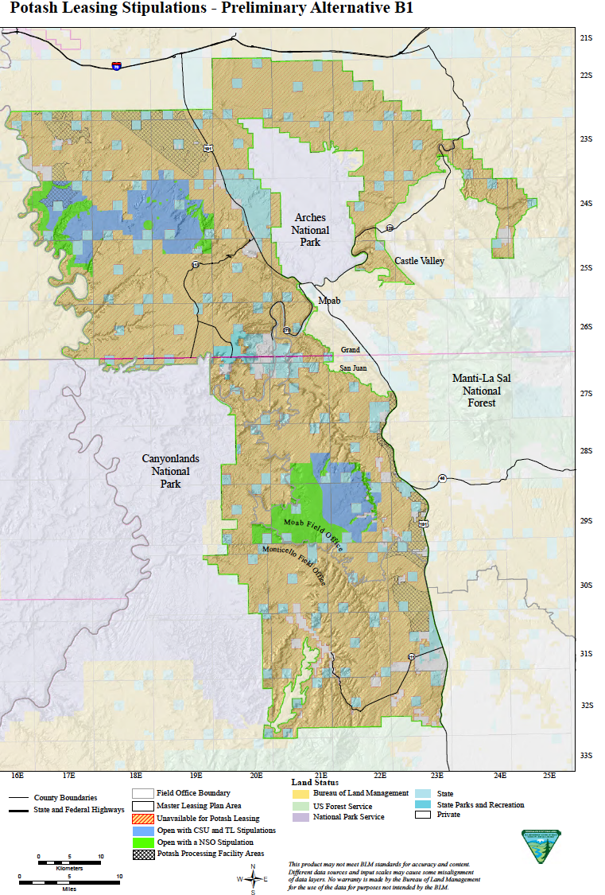
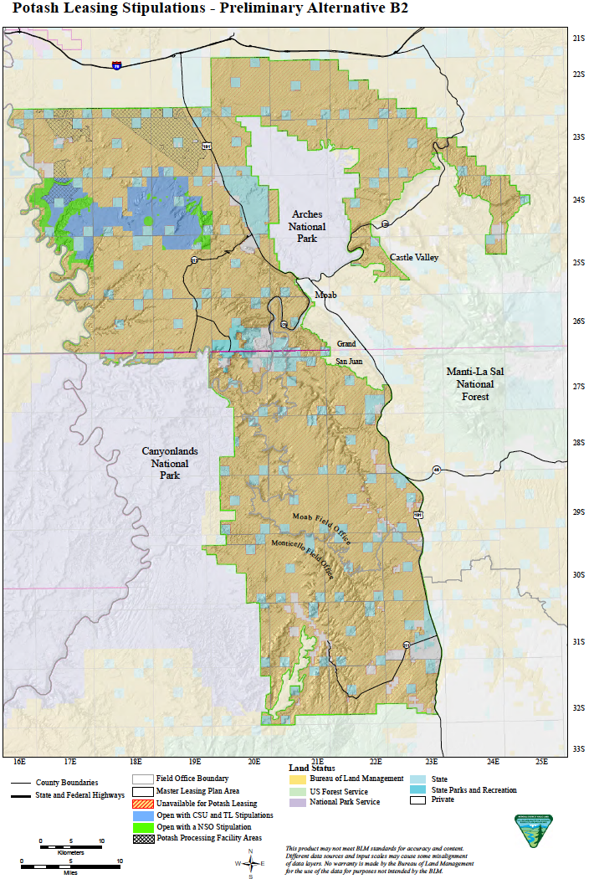
Potash: existing conditions, Alternatives B1 and B2

Slide 20
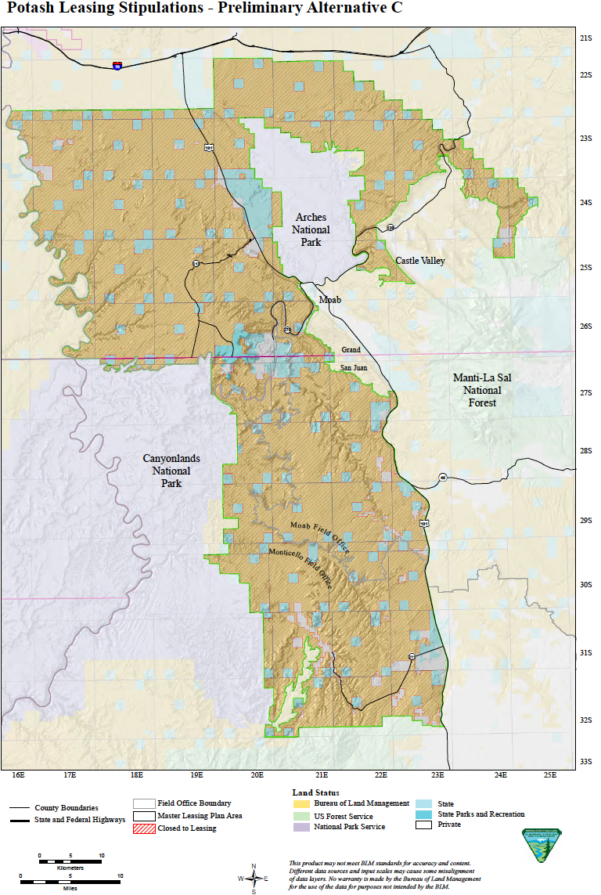
Potash: Alternative C and Business Proposal

Slide 21
Greater Canyonlands
National Monument Proposal
Pros:
Provides permanent landscape protection for the area in the Monument boundaries
Cons:
Management plan is developed after the presidential proclamation

Slide 22
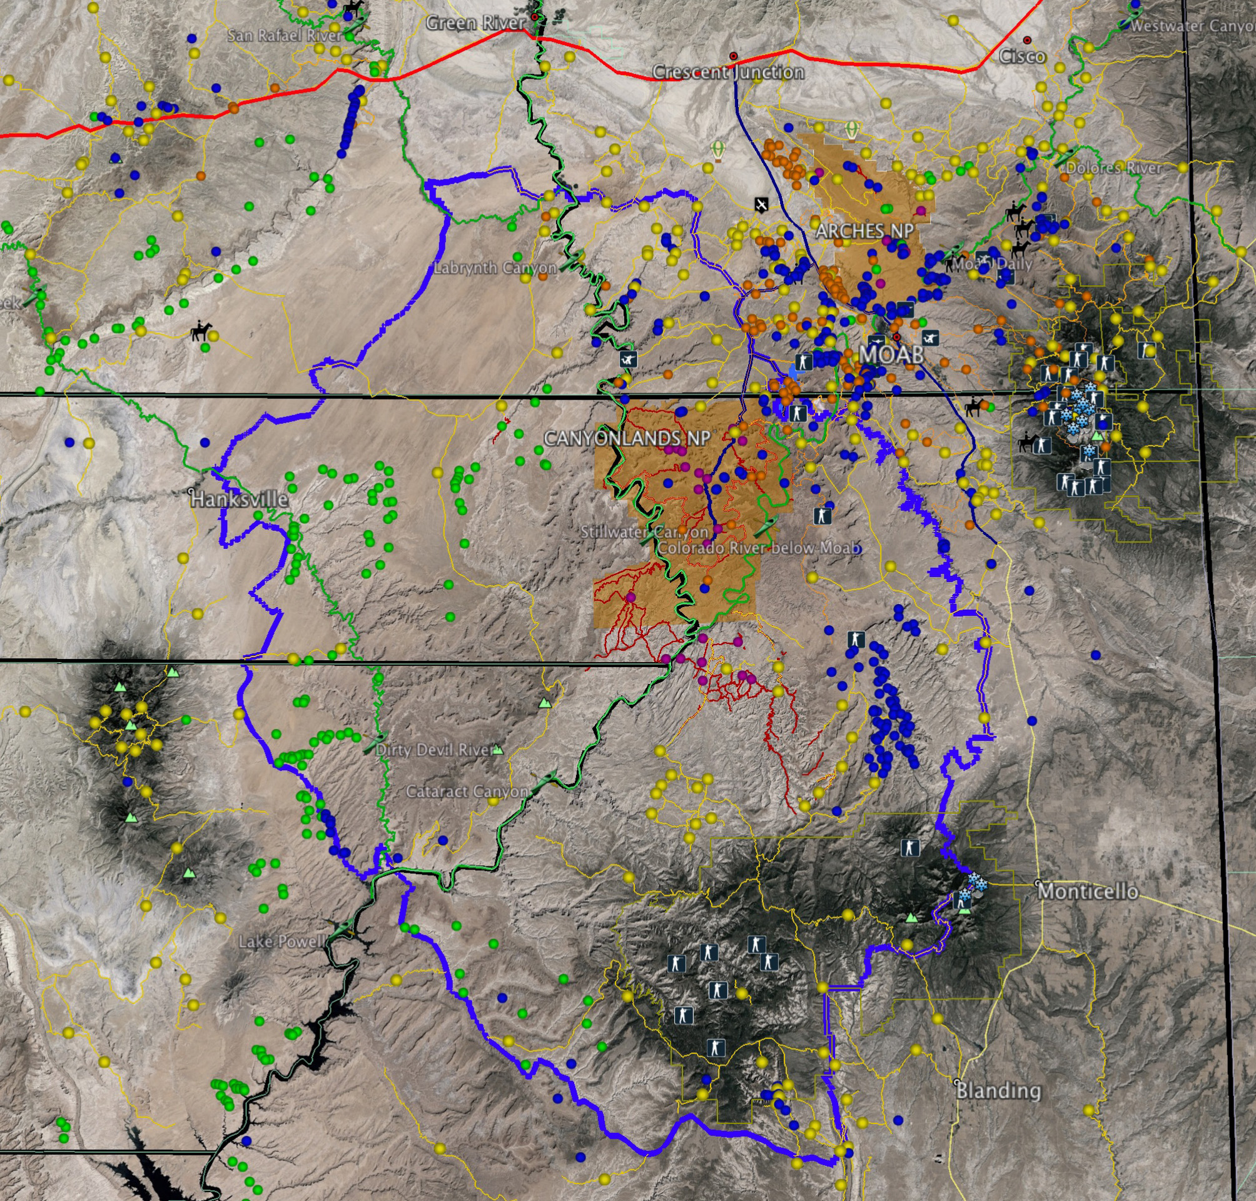
Greater Canyonlands National Monument Proposal

Slide 23

Our choices, our future
Communities around the country have taken control of their federal lands by getting involved, crafting local solutions, and working with their elected officials and land managers.

